Slide 1
NDRRMC Monitoring System
Carpio, aira joyce
Haboc, Florence gail
Salazar, arnold

Slide 2
Problem
Lack of capacity and technical expertise
Lack of public awareness or the threats and impacts of all types of hazards
Lack of necessary skills to cope with the impacts of disaster
Lack of communication and coordination

Slide 3
Description
Tracks relevant data from different NDRRMC independent systems (e.g. Logistics, Inventory, Procurement, etc.)
NDRRMC admin sends report for Law and Order
LGU admins receive a notification about the upcoming disaster details

Slide 4
Objectives
General Objectives
To increase community disaster awareness and improve disaster preparation coordination
Specific Objectives
To enable users to be updated about the reports
To have the users a coordination with each other
To help users in decision-making for disaster preparation and respond

Slide 5
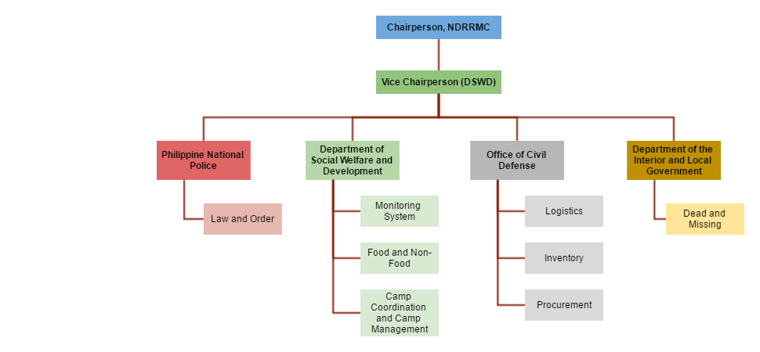
Target User

Slide 6
Scope
The coverage of NDRRMC Monitoring System is the following:
NDRRMC Monitoring System collects the data from different resources or system
NDRRMC Monitoring System data gathered from Law and Order Report will be send to responsible user/s as notification
NDRMMC Monitoring System provides summary reports in form of dashboards using analytic tool

Slide 7
Limitations
Account for LGUs, NDRRMC member agencies, admins of different NDRRMC system
Produce summary reports of the data of each of the system
Report details that is being notified to users heavily depends on Law and Order System

Slide 8
Review of Related Literature/System
Sahana Eden (Emergency Development ENvironment)
Pentaho Analysis Tool
Karnataka State Natural Disaster Monitoring Centre (KSNDMC) GIS System

Slide 9
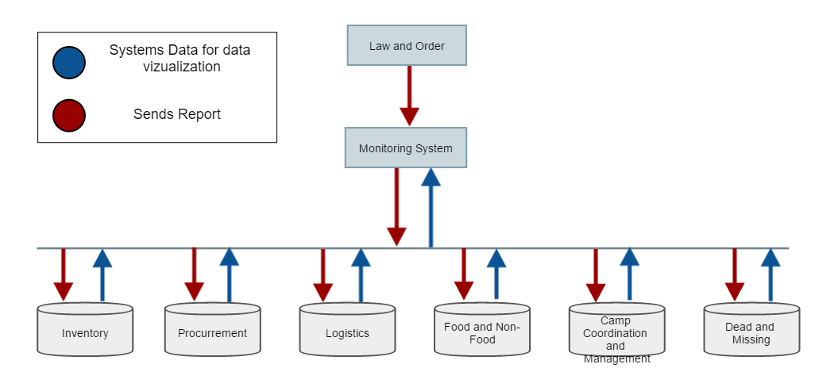
Conceptual Diagram

Slide 10
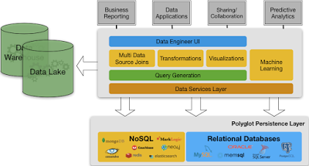
Proposed BI Tool

Slide 11
Features and Functions

Slide 12
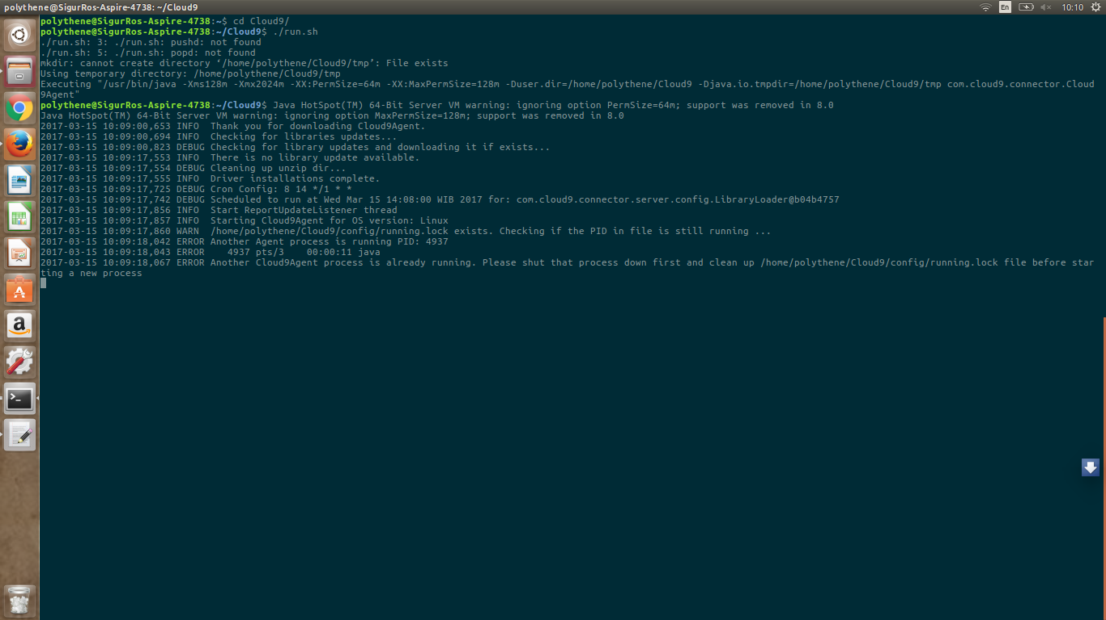

Slide 13
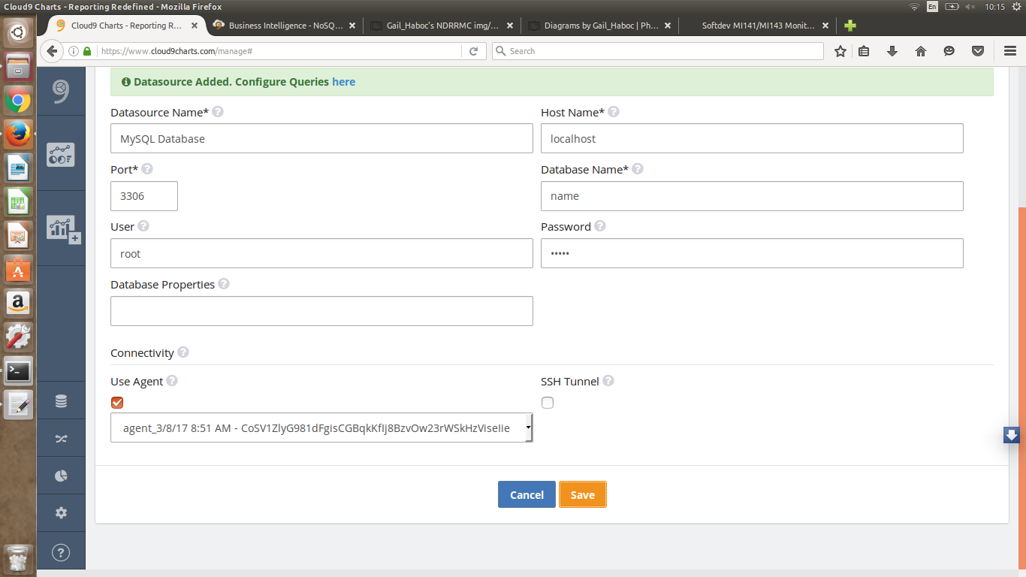

Slide 14
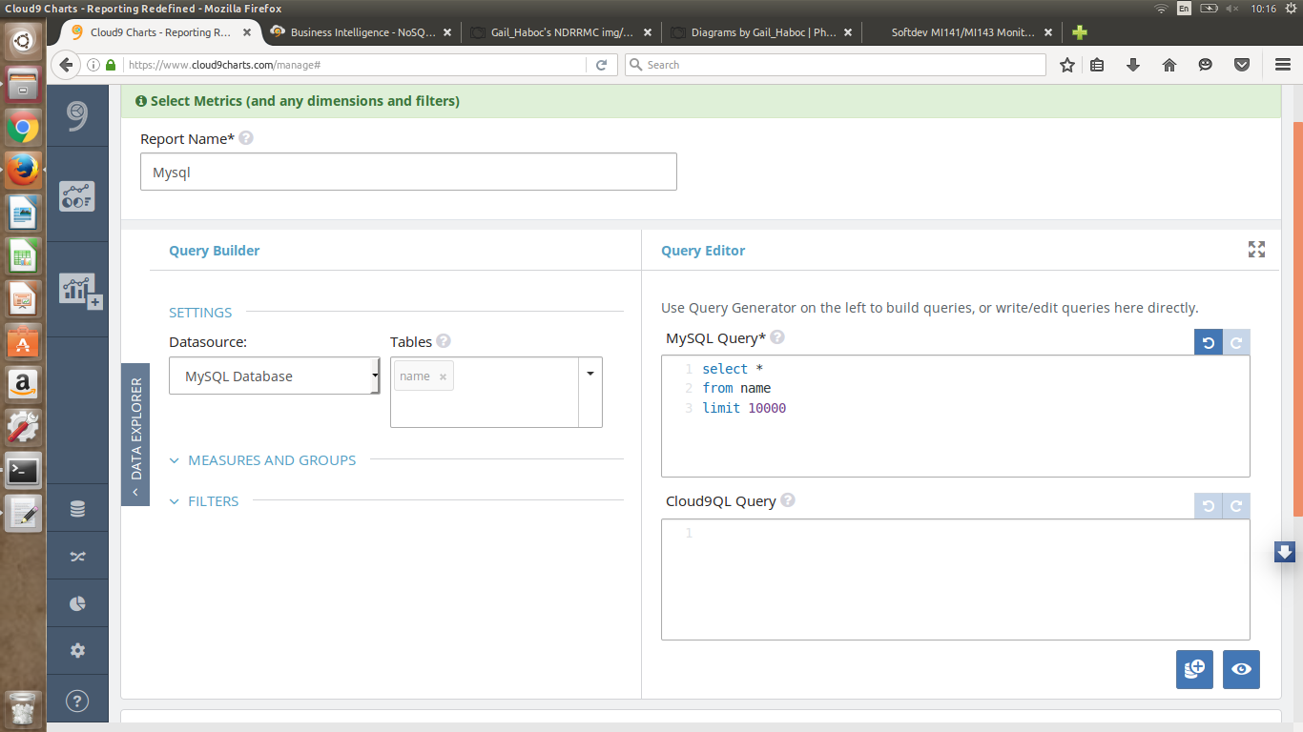

Slide 15
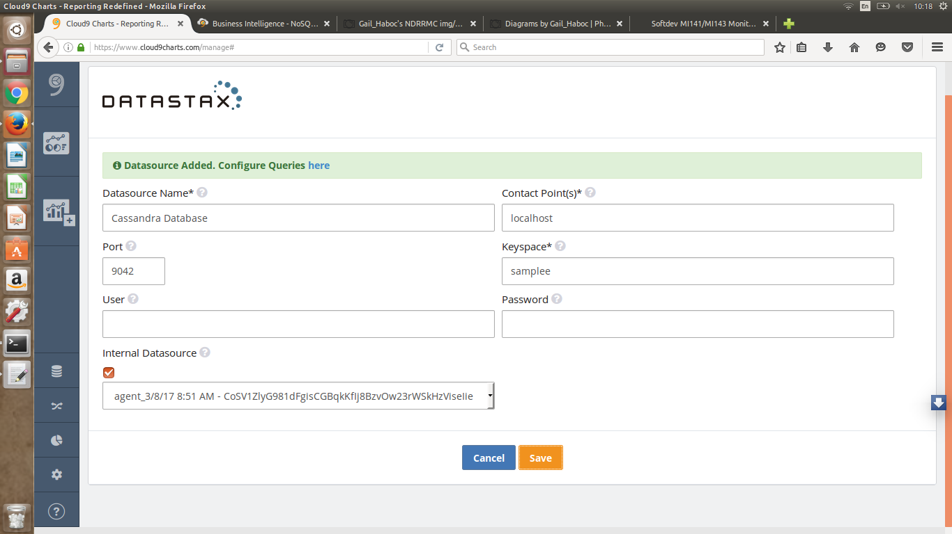

Slide 16
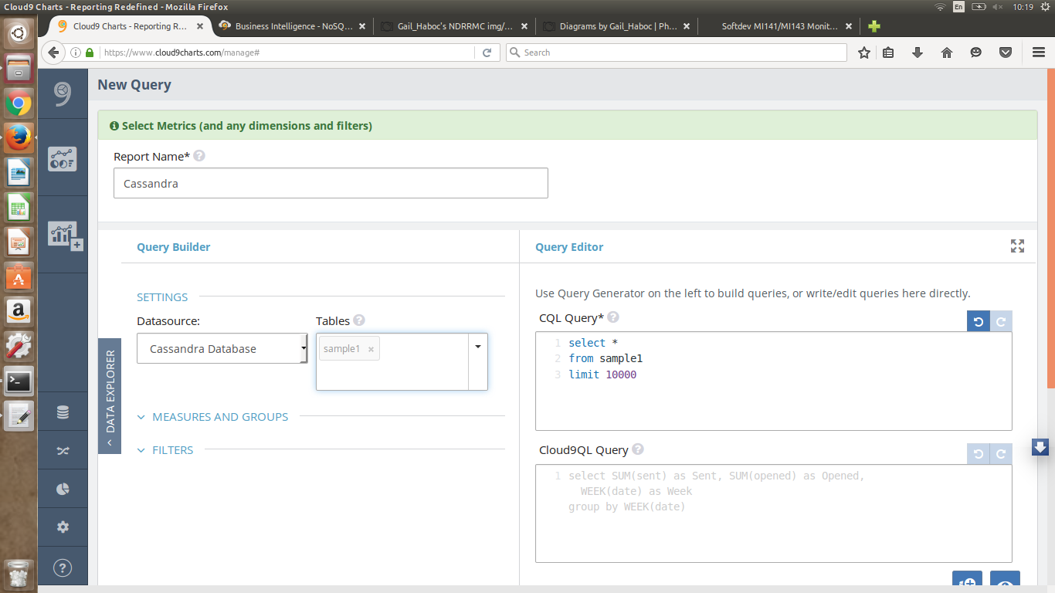

Slide 17
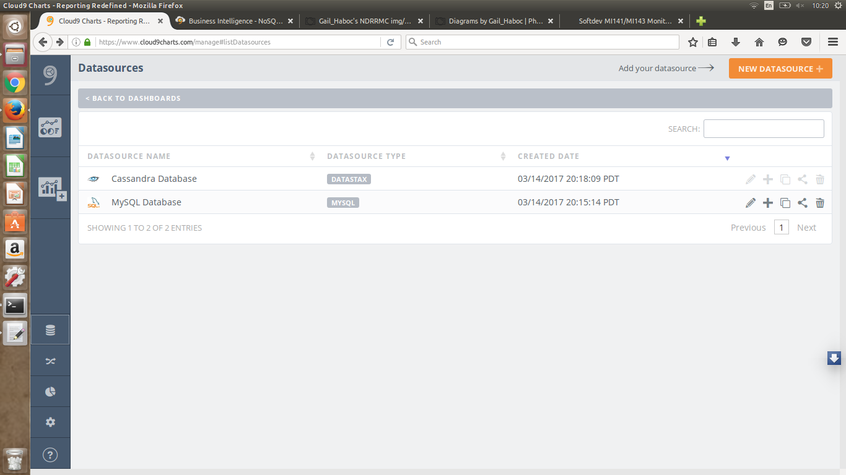

Slide 18
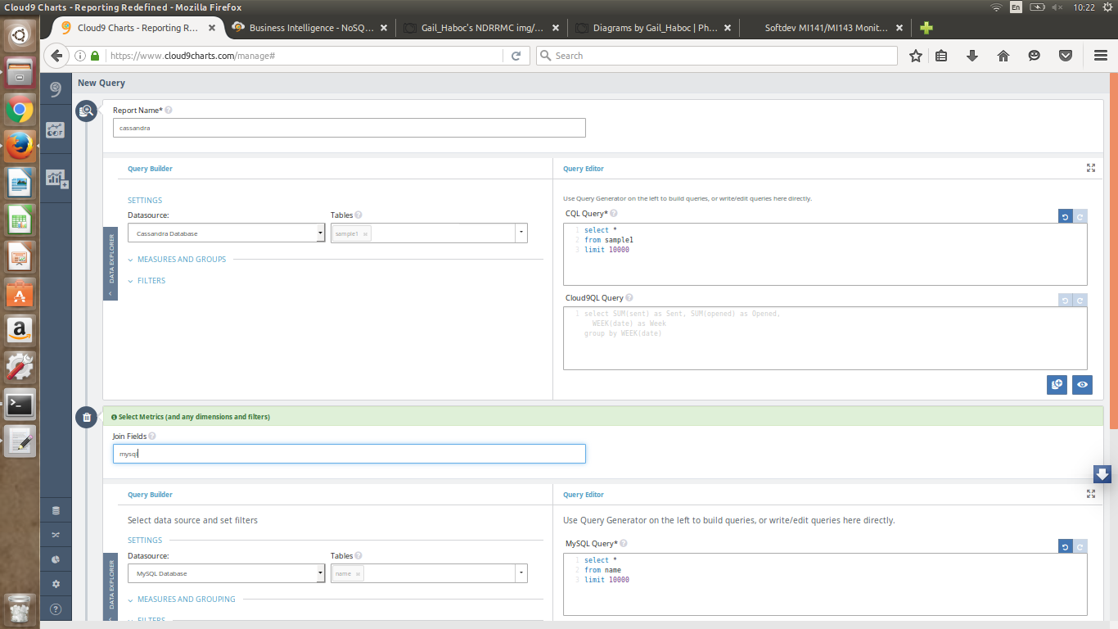

Slide 19
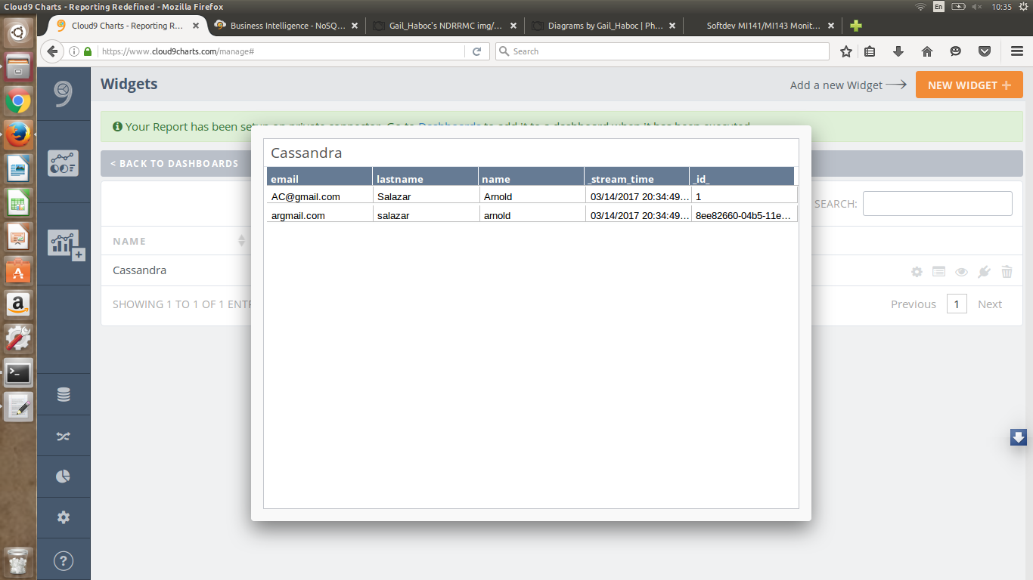

Slide 20
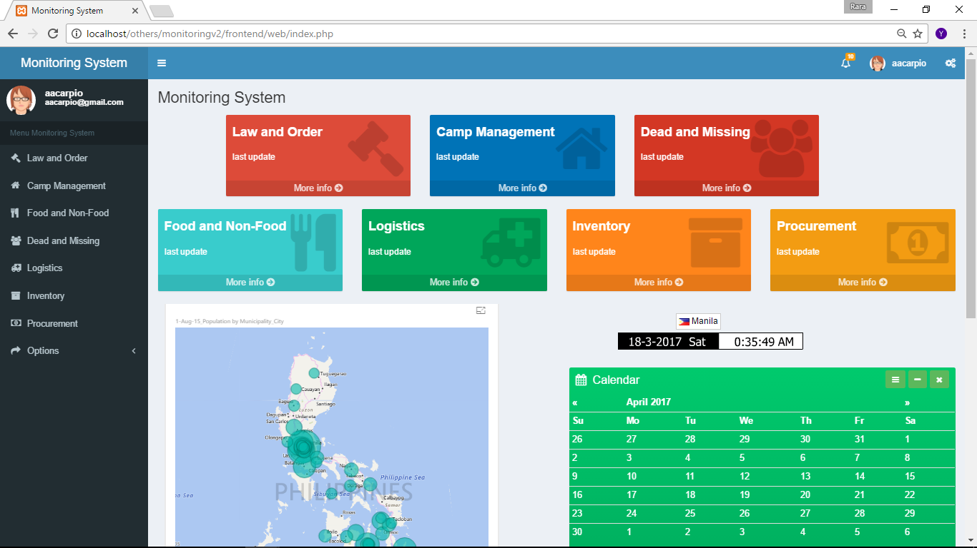

Slide 21
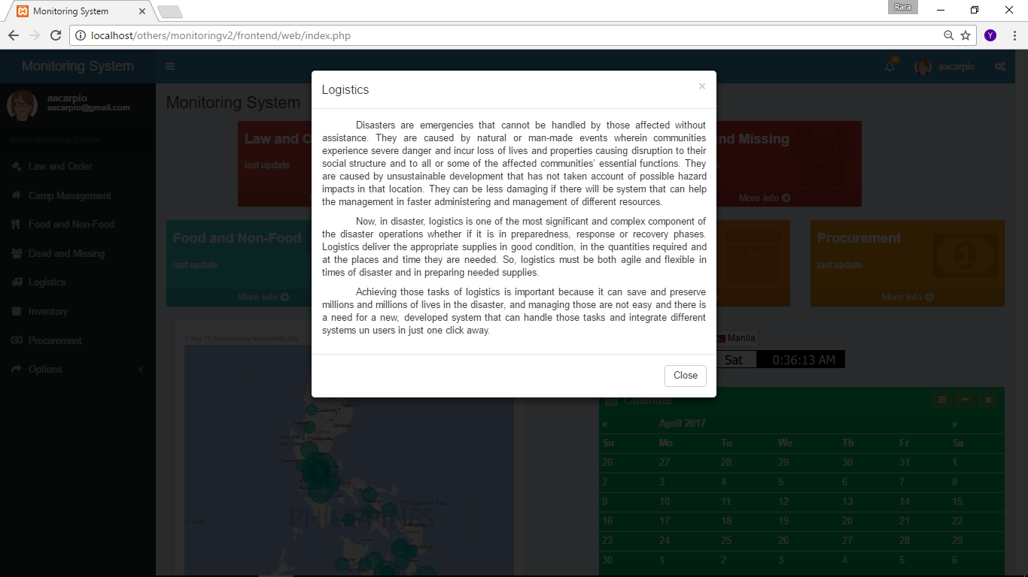

Slide 22
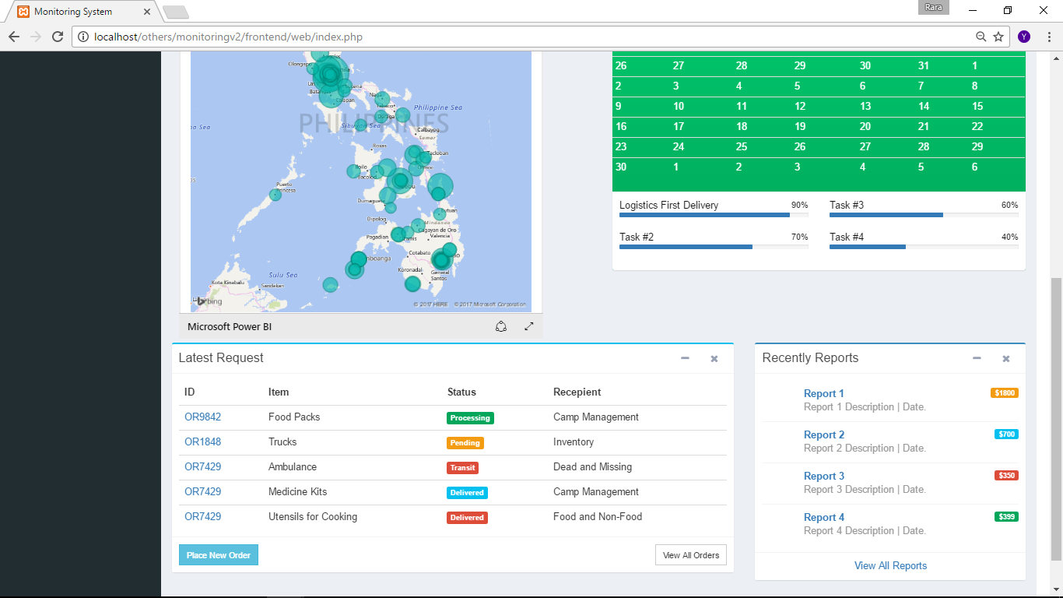

Slide 23
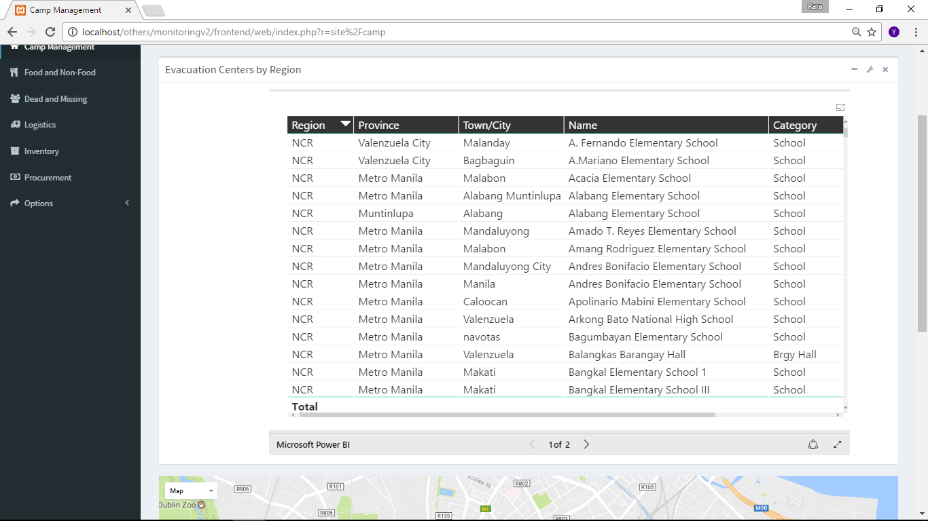

Slide 24
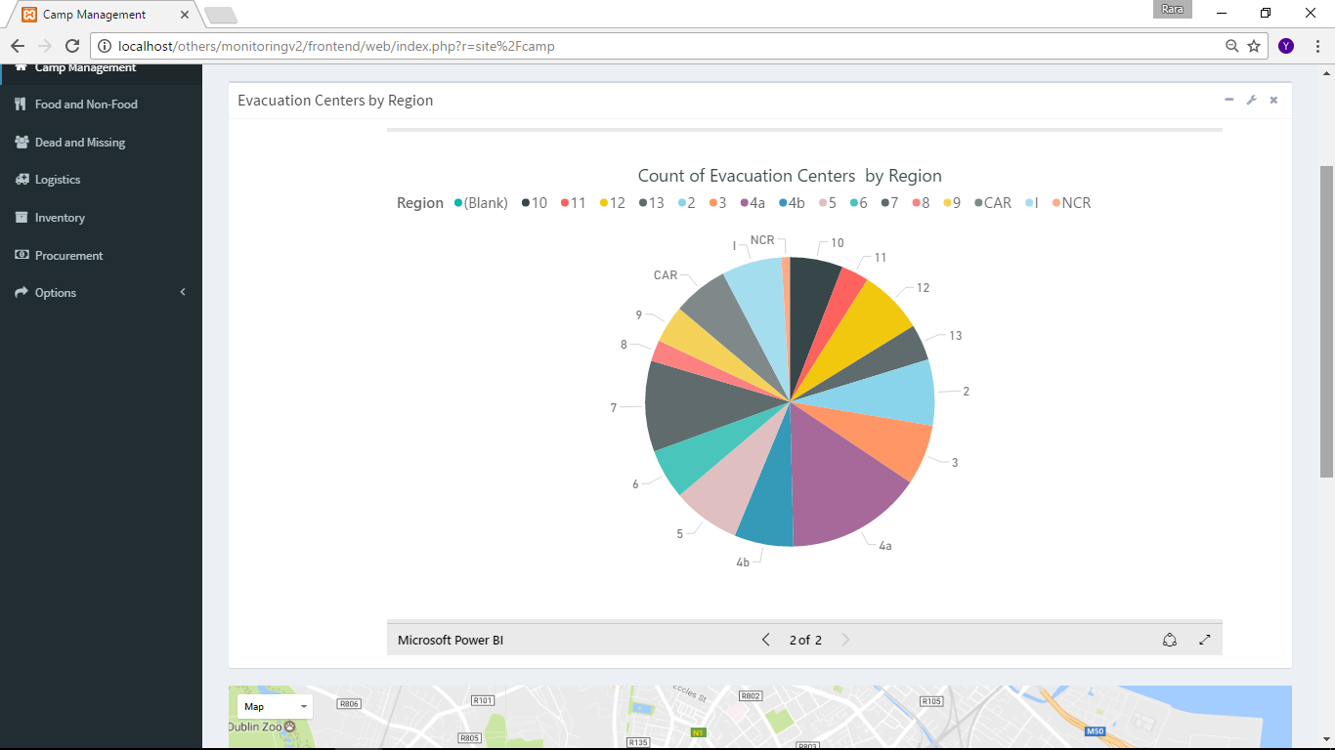

Slide 25
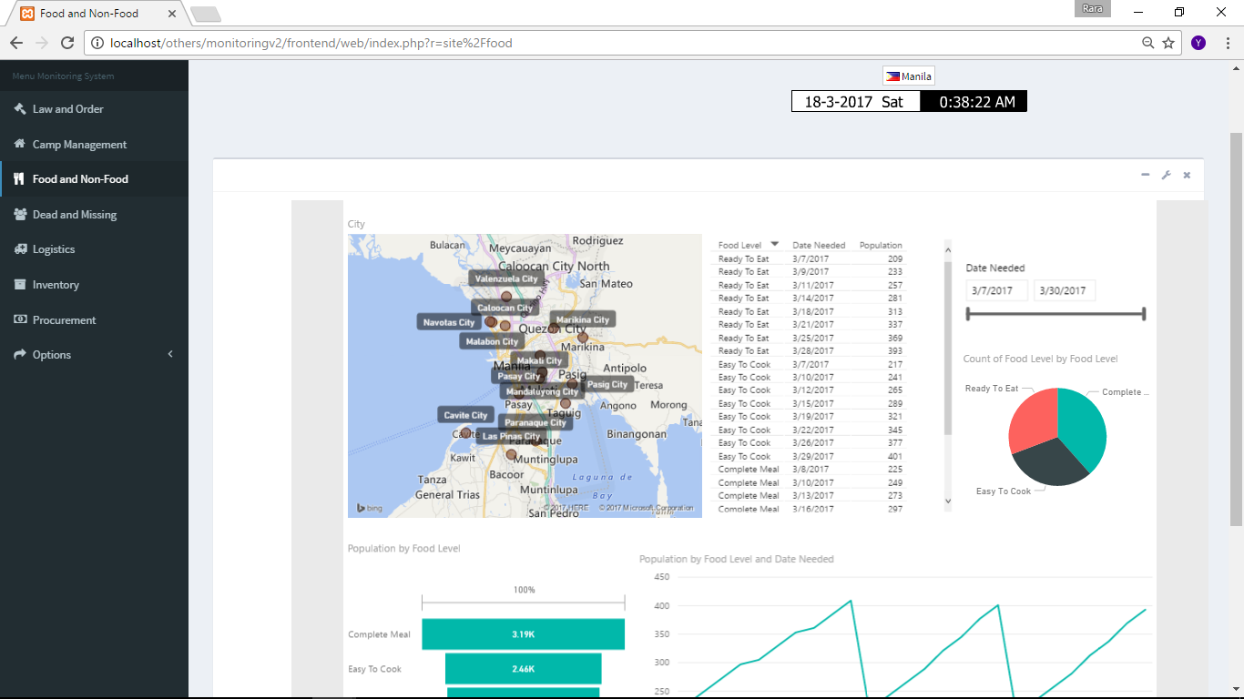

Slide 26
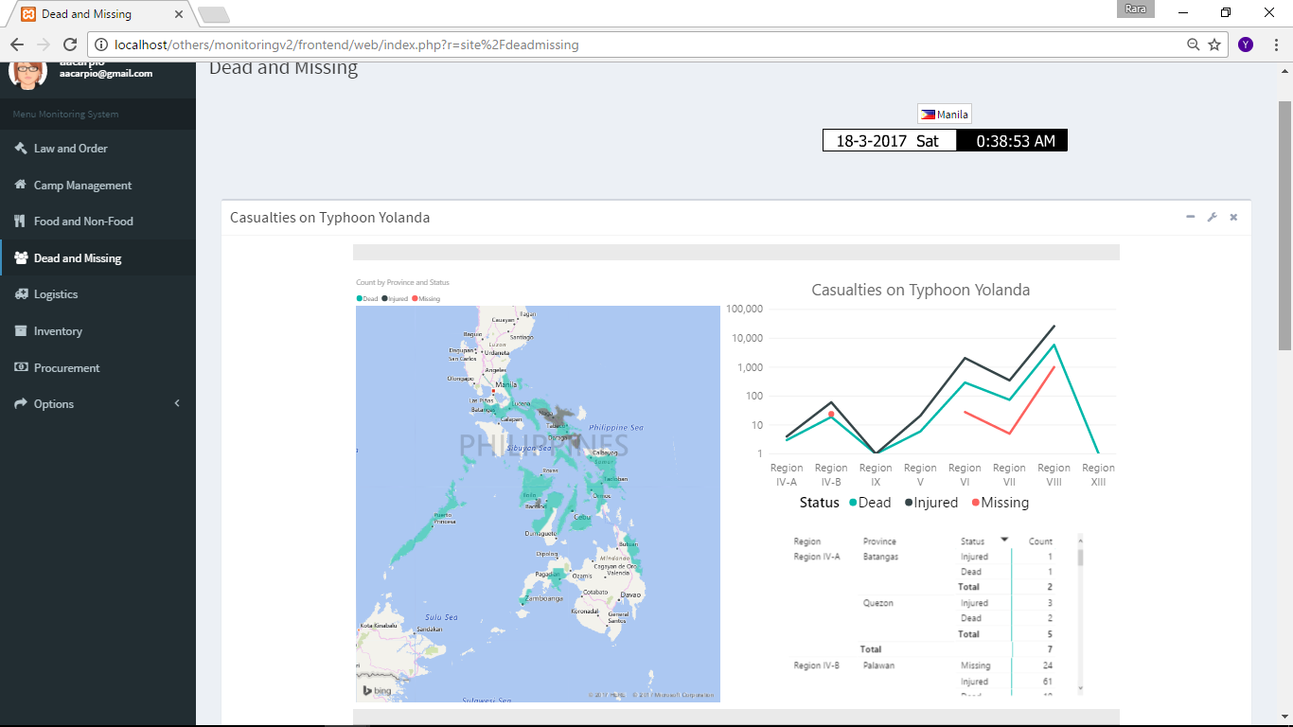

Slide 27
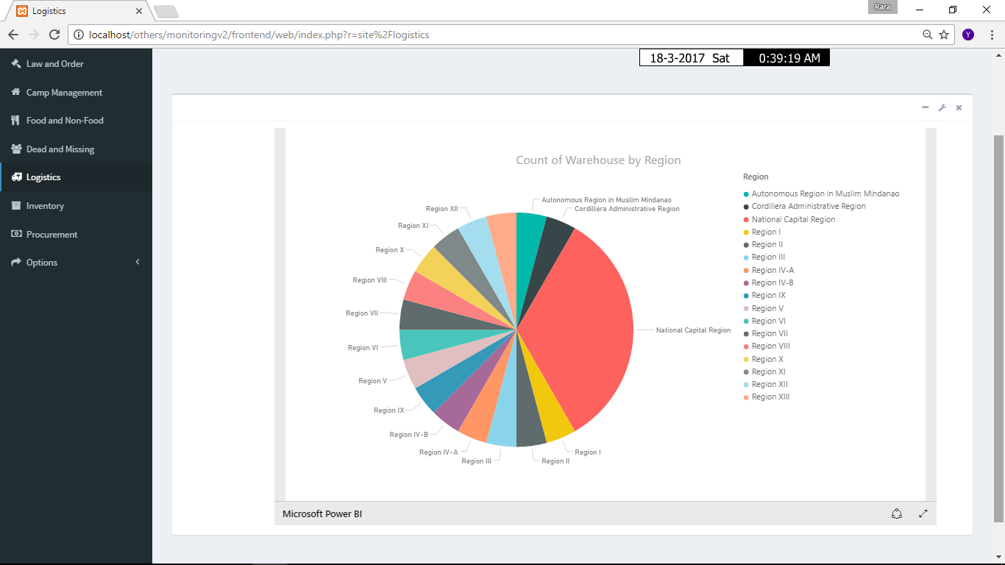

Slide 28
